Slide 1
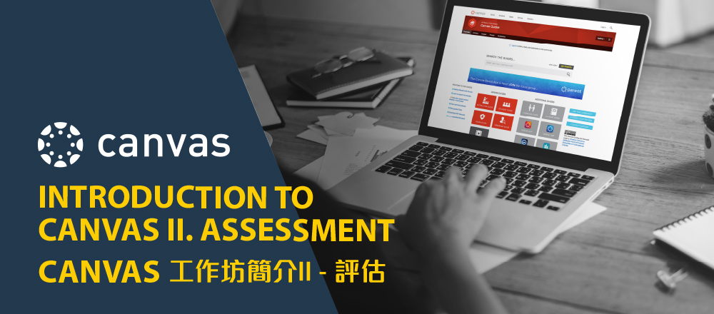
Louise Lee
Senior Educational Designer, EDuIT

Slide 2
Assessment
Collecting, recording and analysing of data about a student's progress
Determining students' achievement of learning outcomes
Constructive Alignment Principle: The alignment between learning outcomes, learning activities and assessment (from Outcome-based Education)
Notes:
定義 收集 進展 學習成果 關連
基於學習成果的學習
合理

Slide 3
Types of Assessment
Formative assessment 形成性評估
It is given throughout the course. It can modify and maximize students' learning experiences, faster feedback, flexibility
Summative assessment 總結性評估
Monitors if students achieve the outcomes and provides for program improvements in the future.
Notes:
反饋
Daily, weekly, biweekly – small quizzes, tests, Q&A, competition – for students to monitor themselves, feedback,
改善學習
Exam – fulfill the expectation 期望

Slide 4
Product vs Process
Past
Present
Quiz
Discussion
Assignment
Final test
Midterm
Formative
Summative
Formative
Peer Assessment
Self Assessment
Quiz
Discussion
Assignment
Summative
Final
Midterm
Notes:
Product 成果 vs Process過程
In the past assessment has focused too heavily on the final artwork or product as the sole measure of a student's achievement. The evaluation of this product must be balanced with an examination of the process each student has undergone.
Quizzes – provide self-check, immediate
Peer Assessment The role of constructive criticism is also important to consider. As involvement in the visual arts is a subjective and often individual experience, positive, constructive criticism should be emphasized so as to build confidence and encourage students' efforts of self-expression. While students may need direction initially about critiquing their peers' work in this manner, once developed their insight and support can be a valuable assessment tool for students and teachers alike.
Students' ability to assess and correct their own work, assess the work of their learning partners, and give and receive constructive criticism are important skills to develop in any evaluative process. The ultimate purpose of assessment and evaluation is to develop students' self-evaluation skills, necessary for life-long learning and success.

Slide 5
Why Canvas?
English Version: https://hkapa.learnnshare.com.hk/Panopto/Pages/Viewer.aspx?id=008d585e-8655-4d80-9850-ac25004244fd
Cantonese Version:
https://hkapa.learnnshare.com.hk/Panopto/Pages/Viewer.aspx?id=01fa6583-734a-4c20-a5e0-ac25003dd837
Notes:
Findings
Devices: Over half of respondents (59% of the faculty and 52% of the students) believe that students’ lack of access to devices negatively affected their learning. (Appendix A. Table 3-5)
Internet Access: 74% of the teachers and 51% of the students reported that students need better access bandwidth/wifi to continue synchronous online learning. (Appendix A. Table 6-8)
Asynchronous learning platforms: About half of the respondents (46% of the faculty and 51% of the students) have used Canvas. Many of these Canvas users (97% of the faculty and 71% of the students) reported that this type of platform is useful in supporting learning and teaching. (Appendix A. Table 9-13.)
Recommendations
Canvas should be more widely adopted to support online learning, while other asynchronous learning, i.e., mailing out textbooks or digital files, can also be considered
To alleviate student frustration, Schools must be clear in their messaging, identifying what can and cannot be taught online and adjusting their curriculum accordingly. Carefully plan which content should be delivered synchronously (live) and asynchronously via online resources

Slide 6
Rubrics

Slide 7
Rubrics
For Teachers
Reduce the time spent on grading or writing lengthy comments
Help teachers identify strengths and weaknesses across the class and adjust their instruction appropriately
Improve consistency across time and across graders
For Students
Understand teachers’ expectations and standards
Recognize their strengths and weaknesses and direct their efforts accordingly
Use feedback to improve their performance

Slide 8
Different components of a rubric
Writing Rubric 1 | Attainment 表現水平
Assessment method (評核方法) | A, A- 86-100% | B+, B, B- 71-85% | C+, C 61-70% | C-, D+, D 41-60% | F 0-40%
Assessment Dimensions 評核範疇 | Excellent 優 | Good 良 | Adequate 常 | Minimal 可 | Inadequate 劣
Attainment: A rating scale that identifies students’ level of mastery within each criterion
Assessment Dimensions:
the criteria that describe the aspects of performance that will be assessed
Content (50%)
Rating descriptors: the characteristics associated with each dimension
Structure (20%)
Language (30%)
Notes:
Rating scale評定量表
Assessment dimension -
Criteria - 標準
Rating descriptors
Content – is it well-researched, evidence研究證據; 學術研究; apply concepts that are learned in the course
Structure

Slide 9
Sample – Generic rubrics
See: https://hkapa.instructure.com/courses/8528/files/138544?module_item_id=60658

Slide 10
References
University of Toronto (n.d.) Assessment in Visual Arts, http://home.oise.utoronto.ca/~hinwood/art_assessment.htm

